Slide 1
Object oriented analysis and design
Module 1: Principles of Visual Modeling
Notes:
Mô hình hóa trực quan, các nguyên lý cơ bản
Shown mô hình online shopping

Slide 2
Objectives
Describe the importance of visual modeling and the role of Model Driven Architecture.
Define the four principles of visual modeling.
Explain what the Unified Modeling Language (UML) represents.
Define the type of process that best relates to the UML.
Notes:
Vai trò và tầm quan trọng của mô hình hóa trực quan, 4 nguyên lý
Giải thích UML vai trò
Tiến trình, quy trình thích hợp áp dụng triển khai trên UML

Slide 3
Where are we?
What is modeling?
Four principles of visual modeling
The UML
Process and visual modeling
Notes:
Đầu tiên chúng ta nói về mô hình, mô hình như thế nào để hiểu, giao tiếp, trao đổi

Slide 4
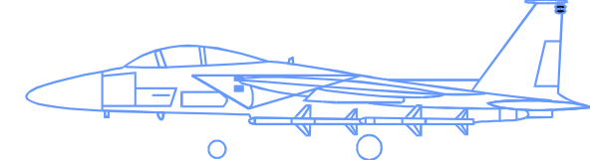
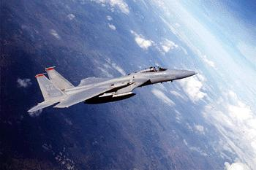
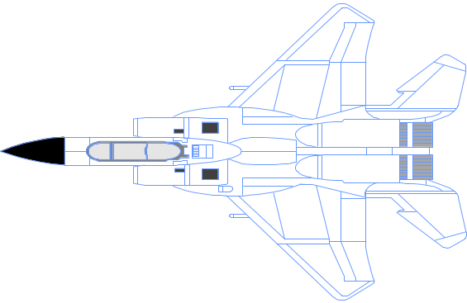

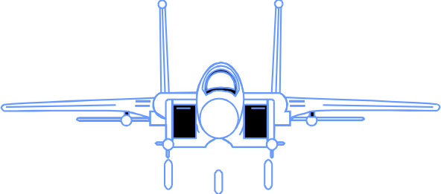
What is a model?
A model is a simplification of reality.
Notes:
Trong thực tế chúng ta biết có rất nhiều mô hình thực tế, sa bàn, chung cư, phần cứng,…
Để tạo ra thực thể cần rất nhiều mô hình
Ví dụ trên mô hình máy bay, đơn giản các góc nhìn khác nhau
Để biểu diễn máy bay cân rất nhiều mô hình.
Phần mềm cần nhiều mô hình biểu diễn, các góc nhìn khác khau, tương tác các thành phần , sơ đồ lơp,…

Slide 5
Why model?
Modeling achieves four aims:
  Helps you to visualize a system as you want it to be.
  Permits you to specify the structure or behavior of a system.
  Gives you a template that guides you in constructing a system.
  Documents the decisions you have made.
You build models of complex systems because you cannot comprehend such a system in its entirety.
You build models to better understand the system you are developing.
Notes:
Chúng ta nói về tại sao mô hình: Mô hình biểu diễn trực quan, dễ hiểu
Mô hình giúp chúng ta quy định cấu trúc, hành vi của hệ thống
Mô hình cung cấp cho chúng ta một khuôn mẫu tạo ra hệ thống
Mô hình giúp chúng ta lập tài liệu, trao đổi các bên liên quan
Các em lưu ý xây dựng mô hình khá phức tạp bởi vì ngay từ bước đầu khi xây dựng dự án chúng ta chưa có cách nhìn đầy đủ

Slide 6
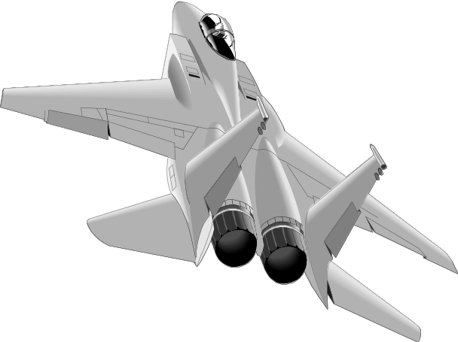

The importance of Modeling
Less important
More important
Paper Airplane
Fighter Jet

Slide 7
Software teams often do not model
Many software teams build applications approaching the problem like they were building paper airplanes
  Start coding from project requirements
  Work longer hours and create more code
  Lacks any planned architecture
  Doomed to failure
Modeling is a common thread to successful projects

Slide 8
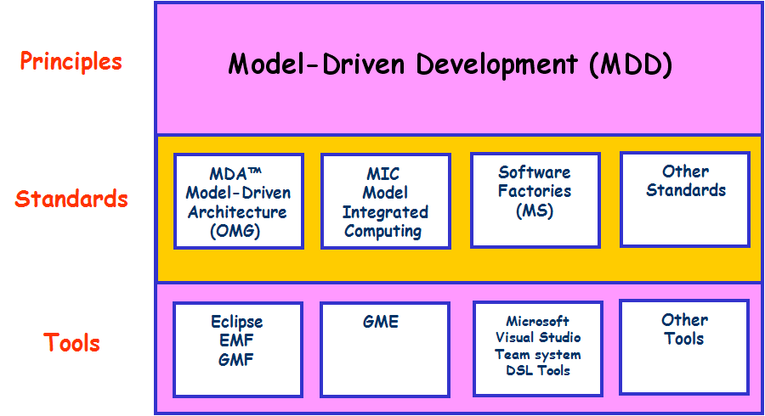
Model Driven Development (MDD)

Slide 9
Where are we?
What is modeling?
Four principles of visual modeling
The UML
Process and visual modeling

Slide 10
Four principles of modeling
The model you create influences how the problem is attacked.
Every model may be expressed at different levels of precision.
The best models are connected to reality.
No single model is sufficient.

Slide 11
Principle 1: The choice of model is important
The models you create profoundly influence how a problem is attacked and how a solution is shaped.
  In software, the models you choose greatly affect your world view.
  Each world view leads to a different kind of system.
Process Model
Deployment Model
Design Model

Slide 12
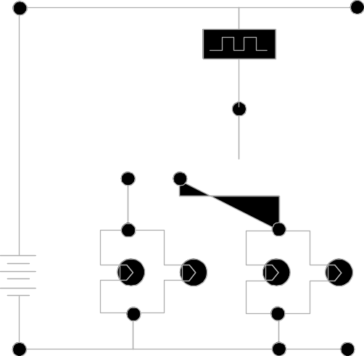
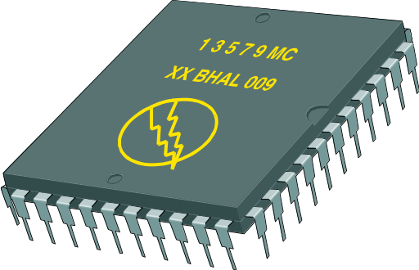
Principle 2: Levels of precision may differ
Every model may be expressed at different levels of precision.
  The best kinds of models let you choose your degree of detail, depending on:
    Who is viewing the model.
    Why they need to view it.
View for customers
View for designer

Slide 13
Principle 3: The Best Models Are Connected to Reality
All models simplify reality.
A good model reflects potentially fatal characteristics.

Slide 14
Principle 4: No single model is sufficient
No single model is sufficient. Every non-trivial system is best approached through a small set of nearly independent models.
  Create models that can be built and studied separately, but are still interrelated.

Slide 15
Where are we?
What is modeling?
Four principles of visual modeling
The UML
Process and visual modeling

Slide 16
What is the UML?
The UML is a language for
    Visualizing
    Specifying
    Constructing
    Documenting
the artifacts of a software-intensive system.

Slide 17
The UML Is a Language for Visualizing
Communicating conceptual models to others is prone to error unless everyone involved speaks the same language.
There are things about a software system you can’t understand unless you build models.
An explicit model facilitates communication.

Slide 18
The UML Is a Language for Specifying
The UML builds models that are precise, unambiguous, and complete.

Slide 19
The UML Is a Language for Constructing
UML models can be directly connected to a variety of programming languages.
  Maps to Java, C++, Visual Basic, and so on
  Tables in a RDBMS or persistent store in an OODBMS
  Permits forward engineering
  Permits reverse engineering

Slide 20
The UML Is a Language for Documenting
The UML addresses documentation of system architecture, requirements, tests, project planning, and release management.
Use Case Diagram
Deployment Diagram
- À©µµ¿ì 95 : Å¬¶óÀÌ¾ðÆ®
ºÐ»ê È¯°æÀÇ ÇÏµå¿þ¾î¹× ³×Æ®¿÷À¸·ÎÀÇ Á¤º¸ ½Ã½ºÅÛ ¿¬°á ¸ðµ¨
- À©µµ¿ì NT: ÀÀ¿ë¼­¹ö
- À¯´Ð½º ¸Ó½Å: ÀÀ¿ë ¼­¹ö ¹× µ¥ÀÌÅ¸ ¼­¹ö, Åë½Å ¼­¹ö
- IBM ¸ÞÀÎÇÁ·¹ÀÓ: µ¥ÀÌÅ¸ ¼­¹ö, Åë½Å ¼­¹ö
Use Case 1
¹®¼­°ü¸®
Window95
Windows95
Windows95
Å¬¶óÀÌ¾ðÆ®.EXE
Windows
¹®¼­°ü¸® ¾ÖÇÃ¸´
Actor A
Use Case 2
Actor B
NT
Solaris
¹®¼­°ü¸® ¿£Áø.EXE
Alpha
Windows
ÀÀ¿ë¼­¹ö.EXE
UNIX
Use Case 3
NT
IBM
Mainframe
µ¥ÀÌÅ¸º£ÀÌ½º¼­¹ö
mainWnd
fileMgr :
document :
gFile
repository
FileMgr
DocumentList
Document
user
FileMgr
Document
add( )
name : int
fetchDoc( )
delete( )
docid : int
Æ¯Á¤¹®¼­¿¡ ´ëÇÑ º¸±â¸¦
1: Doc view request ( )
sortByName( )
get( )
numField : int
read() fill the
»ç¿ëÀÚ°¡ ¿äÃ»ÇÑ´Ù.
open( )
code..
2: fetchDoc( )
close( )
FileList
fList
read( )
sortFileList( )
3: create ( )
add( )
create( )
fillDocument( )
delete( )
1
È­ÀÏ°ü¸®ÀÚ´Â ÀÐ¾î¿Â
6: fillDocument ( )
4: create ( )
5: readDoc ( )
1
¹®¼­ÀÇ Á¤º¸¸¦ ÇØ´ç ¹®¼­
°´Ã¼¿¡ ¼³Á¤À» ¿äÃ»ÇÑ´Ù.
8: fillFile ( )
7: readFile ( )
Repository
rep
File
È­¸é °´Ã¼´Â ÀÐ¾îµéÀÎ
(from Persistence)
read( )
GrpFile
°´Ã¼µé¿¡ ´ëÇØ ÀÌ¸§º°·Î
9: sortByName ( )
name : char * = 0
º¸¿©ÁØ´Ù.
Á¤·ÄÀ» ½ÃÄÑ È­¸é¿¡
readDoc( )
read( )
readFile( )
open( )
create( )
fillFile( )
Sequence Diagram
Class Diagram

Slide 21
History of the UML
UML 2.0
(2004)
UML 1.5
(March, ‘03)
UML
Partners’
Expertise
UML 1.1
(Sept. ‘97)
UML 1.0
(Jan. ‘97)
UML 0.9
(June ‘96)
and
UML 0.91
(Oct. ‘96)
Public
Feedback
Unified Method 0.8
(OOPSLA ’95)
Booch ’93
OMT - 2
OOSE
Other
Methods
Booch ‘91
OMT - 1

Slide 22

Inputs to the UML
Rumbaugh
Booch
Jacobson
Meyer
Fusion
Before and after
conditions
Operation descriptions,
message numbering
Harel
Embley
State charts
Singleton classes,
High-level view
Gamma, et.al
Wirfs-Brock
Frameworks, patterns,
notes
Responsibilities
Shlaer- Mellor
Selic, Gullekson, Ward
Odell
Object lifecycles
ROOM (Real-Time
Object-Oriented Modeling)
Classification

Slide 23
Where are we?
What is modeling?
Four principles of visual modeling
The UML
Process and visual modeling

Slide 24
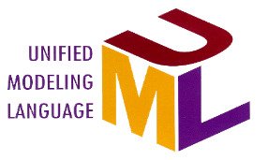

A Language Is Not Enough to Build a System
Team
Based
Development
Modeling
Unified
Language
Process

Slide 25
What Type of Process Most Benefits the UML?
The UML is largely process independent. A process fully benefits from the UML when the process is:
  Use-case driven
  Architecture centric
  Iterative and incremental

Slide 26
A Use-Case Driven Process
Use cases defined for a system are the basis for the entire development process.
Benefits of use cases:
  Concise, simple, and understandable by a wide range of stakeholders.
  Help synchronize the content of different models.
Check Balance
Customer
Withdraw Money

Slide 27
An Architecture-Centric Process
A system’s architecture is used as a primary artifact for conceptualizing, constructing, managing, and evolving the system under development.
Benefits:
  Intellectual control over a project to manage its complexity and to maintain system integrity.
  Effective basis for large-scale reuse.
  A basis for project management.
  Assistance in component-based development.
Notes:
Kiến trúc đóng vai trò cốt lõi, xay dựng, tiến hóa

Slide 28
An Iterative and Incremental Process
Critical risks are resolved before making large investments.
Initial iterations enable early user feedback.
Testing and integration are continuous.
Objective milestones focus on the short term.
Progress is measured by assessing implementations.
Partial implementations can be deployed
Notes:
Đánh giá rủi ro trước khi…

Slide 29
Iterative Development
Earliest iterations address greatest risks.
Each iteration produces an executable release, an additional increment of the system.
Each iteration includes integration and test.
Iteration 1
Iteration 2
Iteration 3
R
R
R
D
D
D
C
C
C
I
I
I
T
T
T
T I M E
Notes:
Các vòng lặp ban đầu giúp chỉ ra các rủi ro

Slide 30
Review
What is a model?
What are the viewpoints of MDA? Describe each one.
What are the four principles of modeling? Describe each one.
What is the UML? Describe each of its four benefits.
What process characteristics best fit the UML? Describe each characteristic.
What is an iteration?

